Slide 1





STAT 31631
Presentation Group 08
Analyzing the Effects of Environmental, Fertilizer, and Management Factors
on Agricultural wheat Yield
Department of Statistics & Computer Science,
Faculty of Science,
University of Kelaniya,

Slide 2

Content
01
Introduction
02
Problem Statement
03
Significance of the Study
04
Objectives
05
Methodology
06
Results and Discussion
07
Conclusion
08
References
09
Contributions

Slide 3







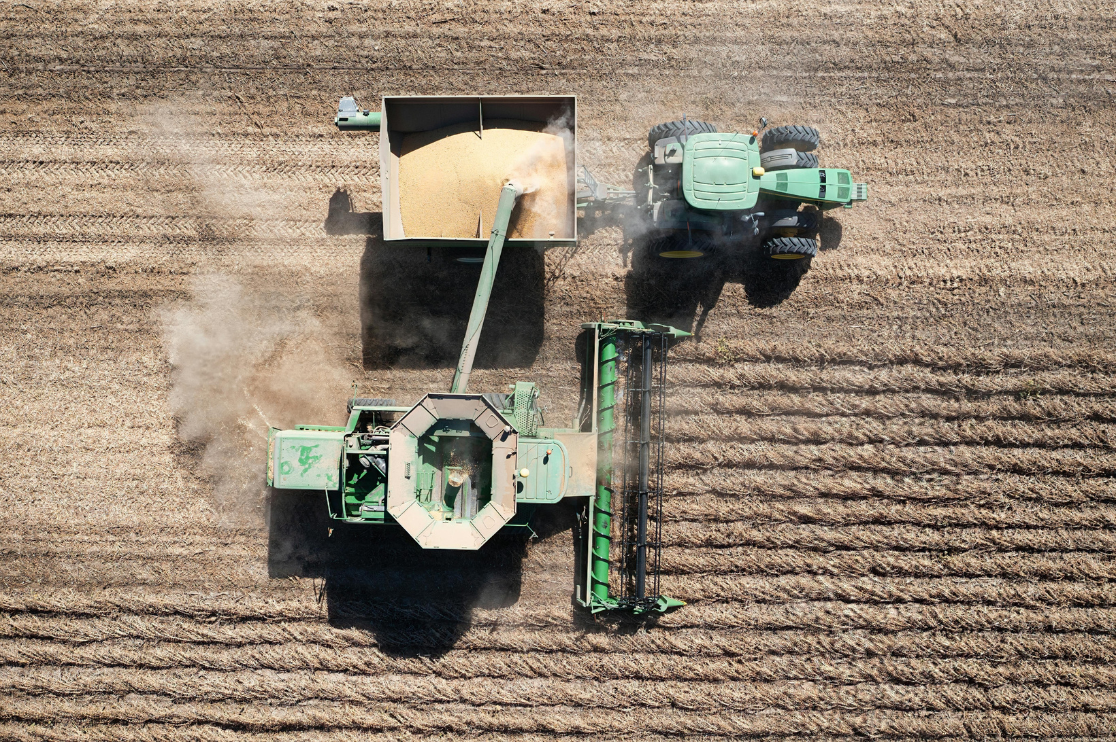
Introduction
Agriculture plays a key role in food security and economic development, but productivity is shaped by complex environmental,fertilizer,and management factors that vary by region. This study aims to quantify the impact of variables like soil quality, seed variety, fertilizer use, climate conditions, and irrigation practices on crop yield, providing insights for optimizing farming practices and promoting sustainable agriculture

Slide 4



Problem Statement
Despite significant advancements in agricultural practices, there remains a gap in understanding how various environmental, fertilizer, and management factors interact to affect agricultural yield. Farmers often rely on traditional knowledge or trial-and-error approaches to determine the optimal conditions for crop production. However, these methods may not fully account for the complex relationships between multiple variables, leading to suboptimal yields and inefficiencies in resource use.

Slide 5





Significance of the Study
This study is significant for several reasons.
Providing a systematic analysis of the factors that influence crop yield and understanding these relationships.
The insights gained from this study can inform policy decisions related to agricultural subsidies, resource allocation, and environmental protection.
group 08

Slide 6


Objectives
To analyze the impact of various environmental factors, fertilizer application , and management practices on agricultural yield.
To identify and quantify the relationships between these factors and crop productivity.

Slide 7





Data Acquisition and Preprocessing
Data Acquisition,Data Cleaning,Data Normalization and Categorical Data Encoding
Exploratory Data Analysis (EDA)
Descriptive Statistics, Correlation Analysis and Data Visualization
Methodology
Building the Regression Model
Variable Selection and model fitting
This project outlines the steps involved in Analyzing the Effects of Environmental, Fertilizer, and Management Factors on Agricultural Yield using multiple linear regression. The data will be obtained from Kaggle ( https://www.kaggle.com/).
Model Evaluation and Interpretation
Assumptions Checking ,ModelFit, Predictor Significance, Multicollinearity Residual Analysis,Interpretation of Results and Conclusion

Slide 8

RESULTS AND DISCUSSION
Briefly discuss the R code and outputs for the project.

Slide 9
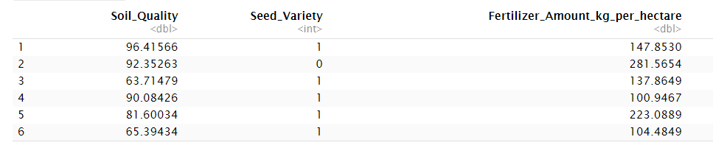
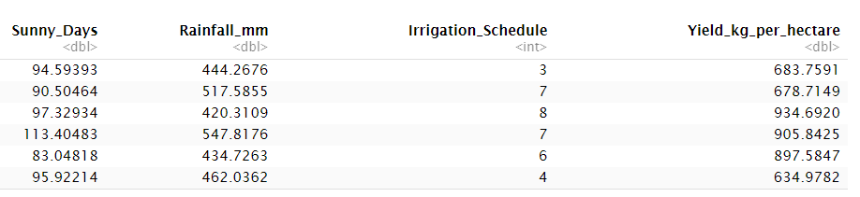
Load necessary libraries
Group 08
library(ggplot2)
library(dplyr)
library(broom)
library(leaps)
library(car)
Read the CSV file
data <- read.csv("agricultural_yield_train.csv")
print the few rows of the data set
head(data)
Check for missing values using colSums
missing_values <- colSums(is.na(data))
print(missing_values)
#There are no missing values in the data frame

Slide 10
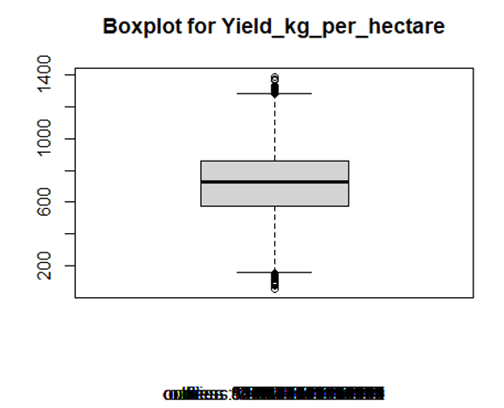
identify outliers using boxplot
boxplot(data$Yield_kg_per_hectare,main = "Boxplot for Yield_kg_per_hectare",sub = paste("outliers :
",boxplot.stats(data$Yield_kg_per_hectare)$out))
Finding outlier rows
outlier_rows <- boxplot.stats(data$Yield_kg_per_hectare)$out
Create a data frame with outlier values
outliers_data <- data[outlier_rows, ]
Remove outliers from the data
cleaned_data <- data[-outlier_rows, ]
Group 08

Slide 11
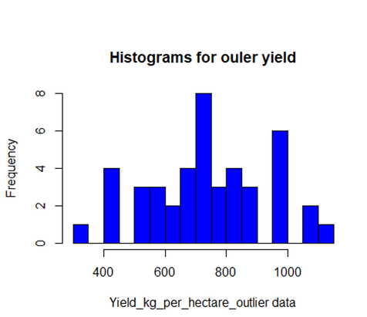

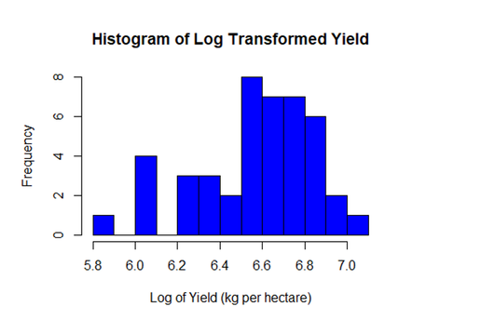

Print the number of rows before and after removing outliers
print(paste("Number of rows before removing outliers:", nrow(data)))
print(paste("Number of rows after removing outliers:", nrow(cleaned_data)))
consider the outlier of data frame
hist(outliers_data$Yield_kg_per_hectare ,xlab= "Yield_kg_per_hectare_outlier data",main = "Histograms for ouler yield",breaks = 12,col = "blue")
Logarithmic transformation
log_yield <- log(outliers_data$Yield_kg_per_hectare)
hist(log_yield, xlab = "Log of Yield (kg per hectare)", main = "Histogram of Log Transformed Yield", breaks = 12, col = "blue")
Group 08

Slide 12
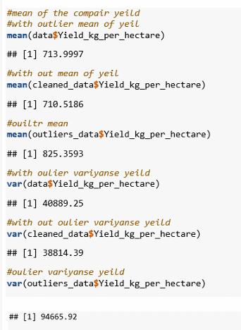
Comparing the means of the yield with and without outliers
Removing the outliers leads to a more consistent dataset with a lower average yield and reduced variability. The outliers have a substantial effect on both the mean and variance, pushing both statistics higher.
Group 08

Slide 13
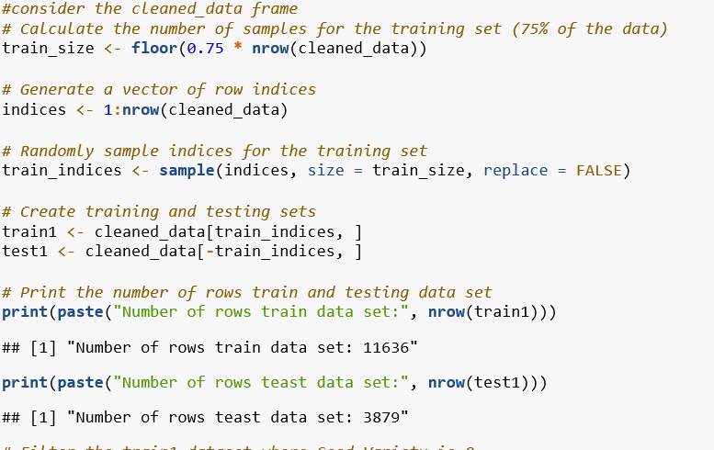

We consider the without outliers data frame
Group 08

Slide 14
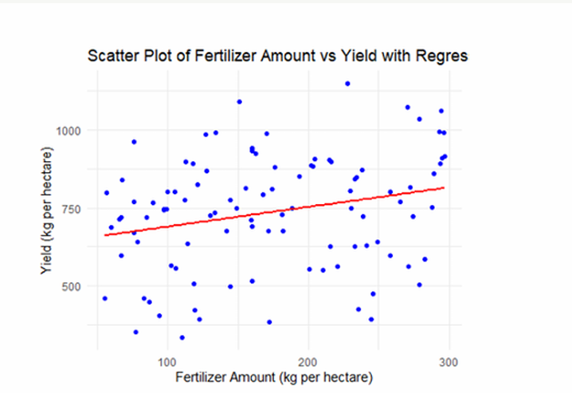
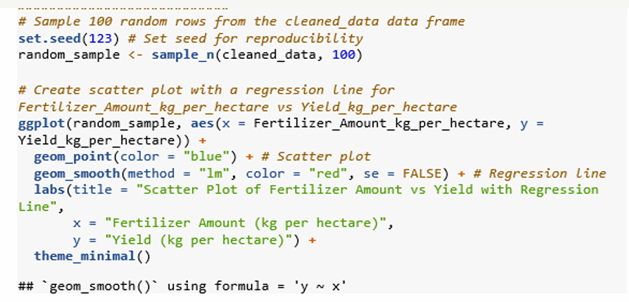
Regression Model creating Part
Group 08

Slide 15
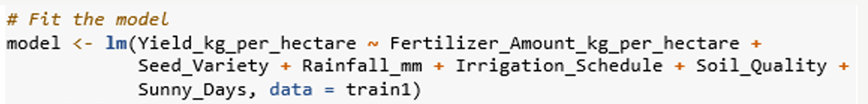
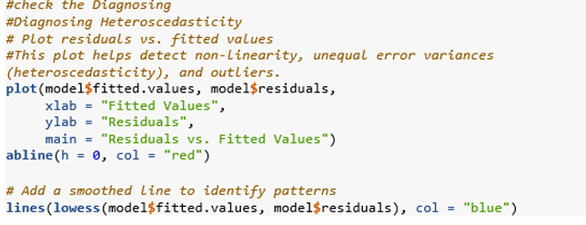

Fit the model
Regression Model Diagnostics
Group 08

Slide 16
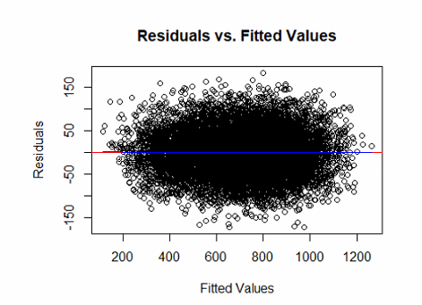
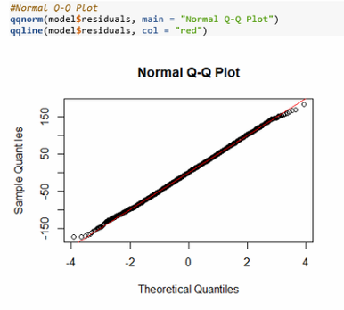
The residuals are randomly distributed There are no clear patterns, curves..
This plot indicates that the residuals of model are approximately
normally distributed
Group 08

Slide 17
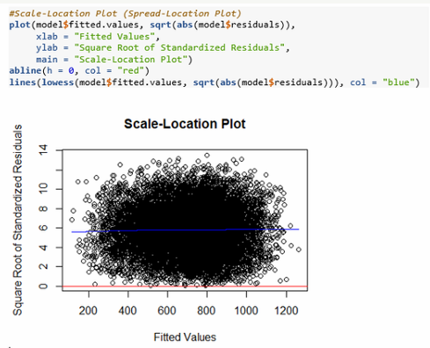
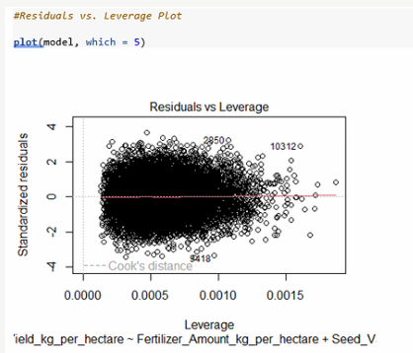
Group 08

Slide 18
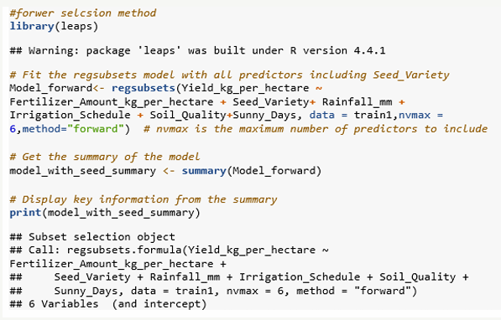
Forward selection method
Group 08

Slide 19

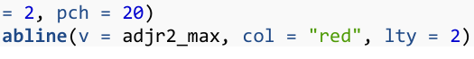
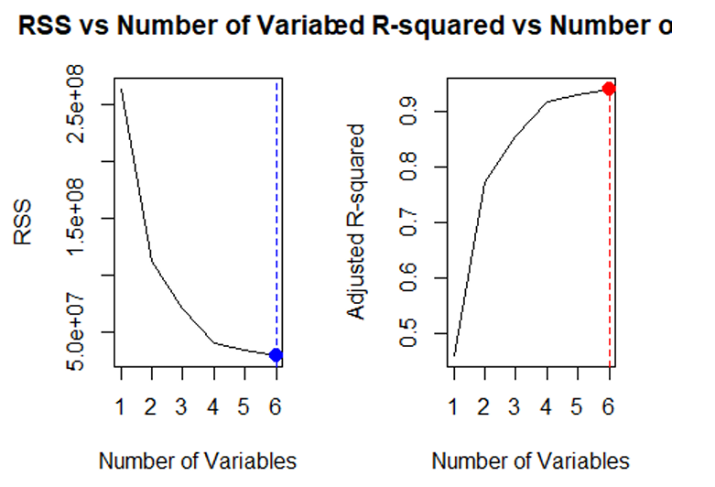

Find and highlight the model with the maximum Adjusted R-squard
Group 08

Slide 20
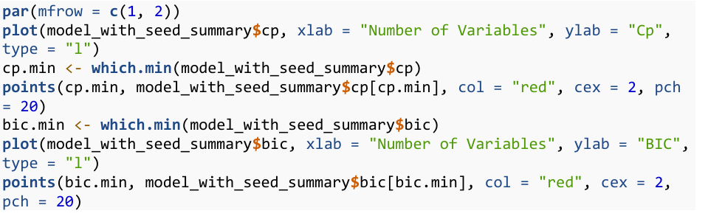
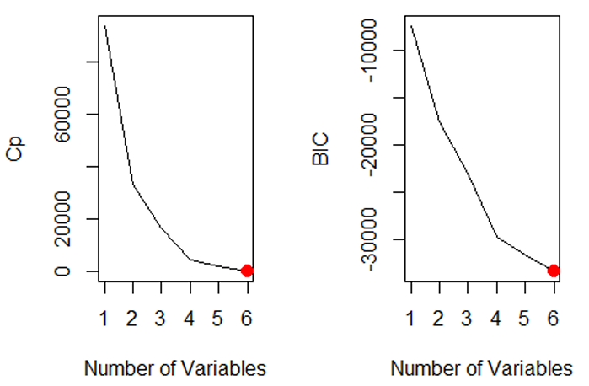

Group 08

Slide 21
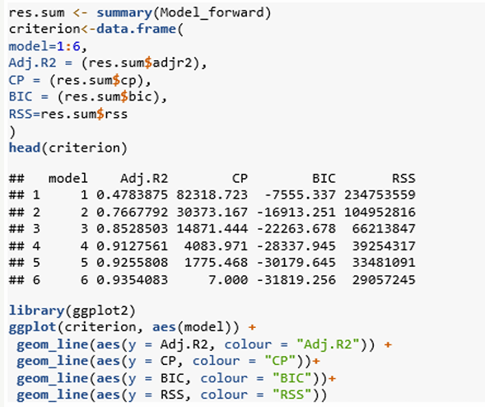
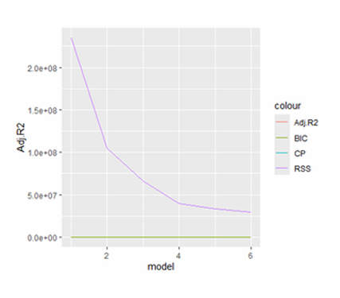
Best Subset selection Method
Group 08

Slide 22
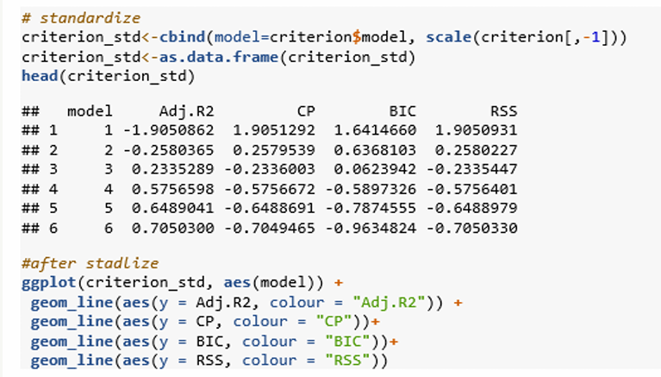
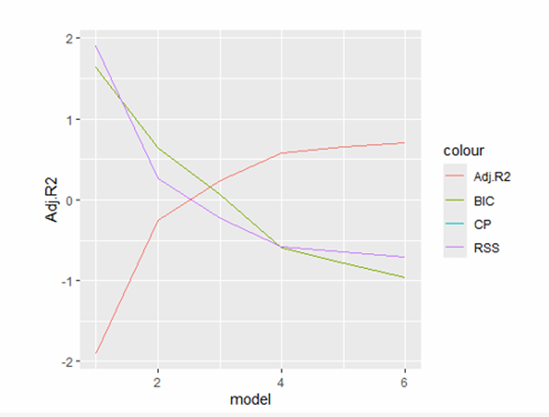
We would ideally choose a model with a relatively high Adjusted R squared, while keeping BIC, CP, and RSS at reasonably low levels
Group 08

Slide 23

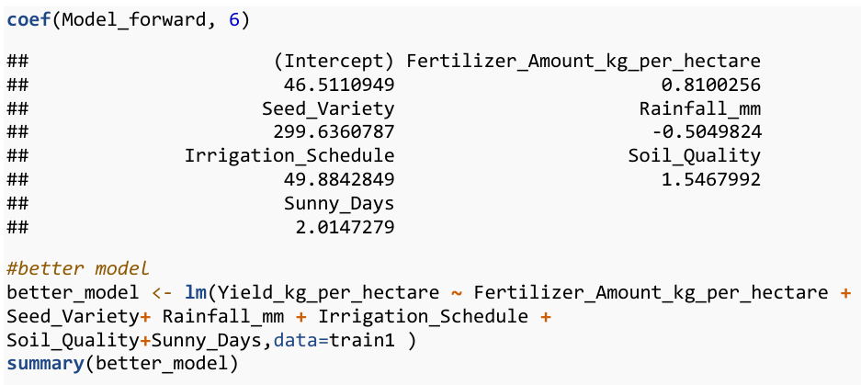
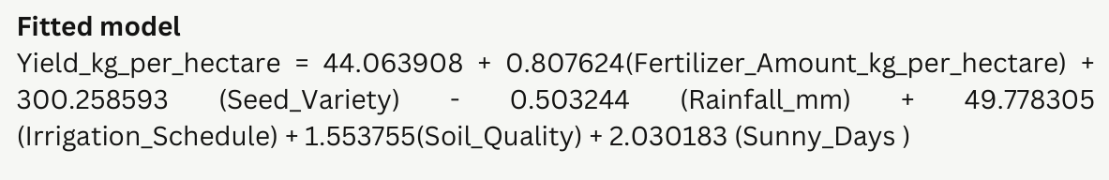
Group 08

Slide 24
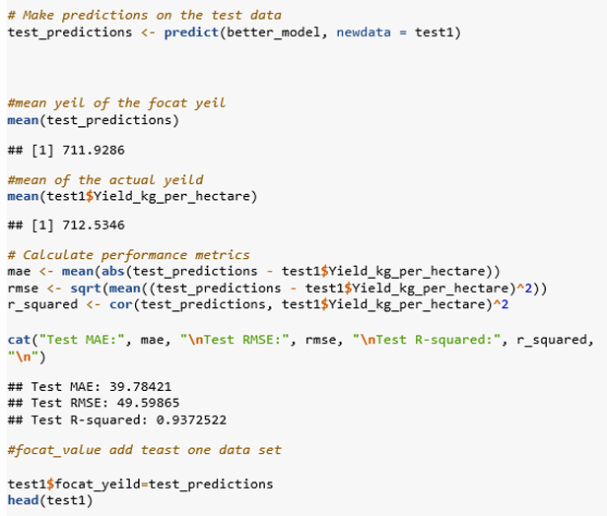
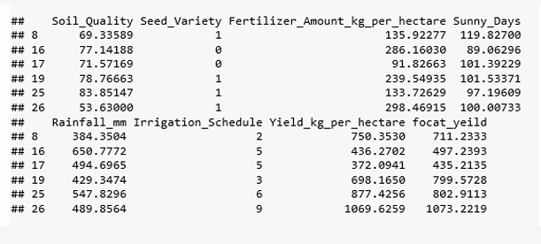
Make predictions on the test data
The adjusted R^2 value on the test data was 0.9373, indicating that the model's predictive power remained strong even on unseen data
Group 08

Slide 25
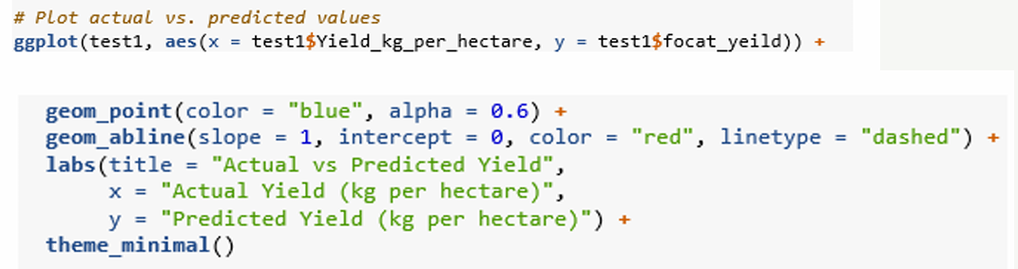
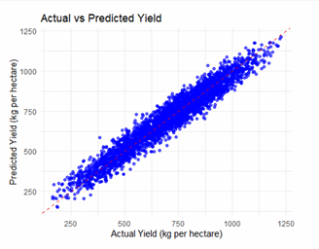
Plot the Actual vs Predicted values
This plot which is comparing actual versus predicted yields showed that the predictions closely aligned with the observed values, further validating the model's accuracy.
Group 08

Slide 26
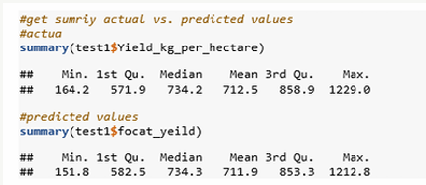

Summary of actual vs predicted values
The summary statistics of the predicted yields were similar to those of the actual yields, with mean values of 711.9 kg per hectare for the predictions and 712.5 kg per hectare for the actual yields.
Group 08

Slide 27
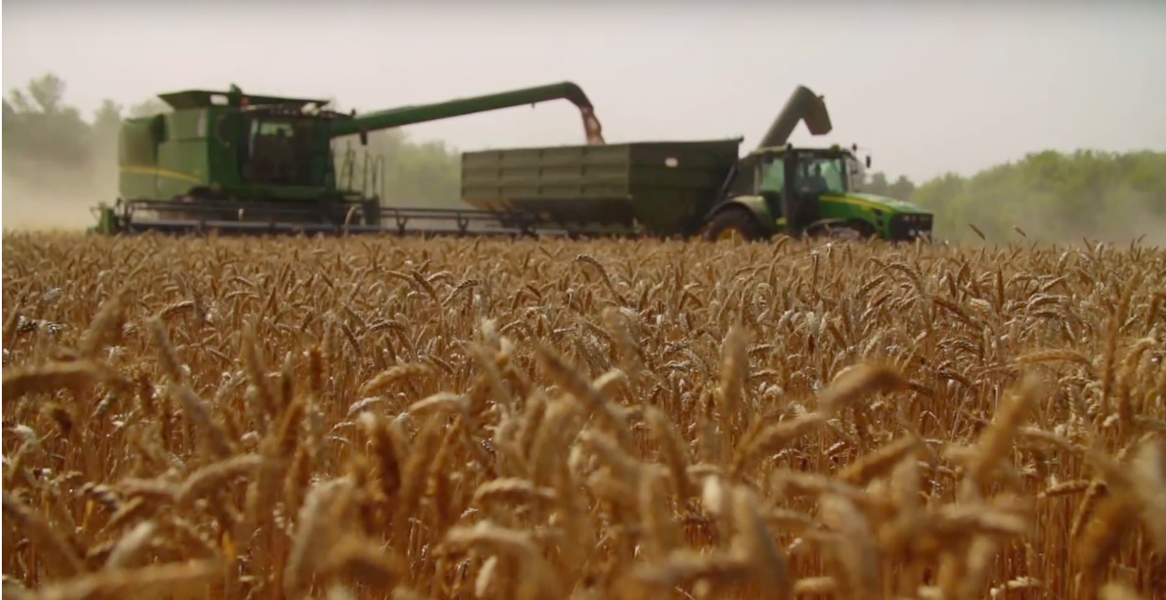


CONCLUSION
This study analyzed the effects of environmental factors and management practices on wheat yield using multiple linear regression. The model explained 93.5% of the yield variability, with key factors showing significant effects:
Fertilizer Amount
Seed Variety
Rainfall
Higher fertilizer use increases yield.
The choice of seed is critical for maximizing yield.
Excessive rainfall negatively impacts yield.

Slide 28





References
data set
books
online Tool
•kaggle.com/datasets/blueloki/synthetic-agricultural-yield-prediction dataset/data
Montgomery, D.C., Peck, E. A. and Vining, G. G. 5th Edition, (2012), ‘Introduction to Linear Regression Analysis’, John Wiley & Sons

Slide 29

Contributions
Everest Cantu
B.L.L. OSHAN
PS/2020/023
W.K.H.RUKSHANI
PS/2020/316
Business Head
PS/2020/141
B.D.H.CHATHURANGA
N.D.K.NADEESHA
PS/2020/258
W.K.S.LAKMALI
PS/2020/186
A.S.S.SILVA
PS/2020/185
Manager
Marketing
Manager
T.M.S.D.THENNAKOON
PS/2020/306
Remy
Marsh
PS/2020/260
P.S.A.LIYANAGE

Slide 30
group 08
THANK YOU
Department of Statistics & Computer Science,
Faculty of Science,
University of Kelaniya,

